Slide 1

COMPLAINT@
2
+
2
+
Complaint Redressal System

Slide 2
RLL – Team Project Batch 8
Batch Members
Name of The Developers Employee ID
Thota Pavan Chand 2528664
Umayal X 2530462
Utkarsh Agarwal 2526906
Vasuki P R 2526804
Vemu Reesa Rejoice 2525919
Vemula Mohith Venkata Sai 2526625
Vishnu Raj Radhakrishnan 2527463
Yaramala Shankar Reddy 2528260
Yellugari Harsha Vardhan Reddy 2526832

Slide 3
1.Introduction 2.Functional requirements 3.Tools and technologies 4.Architecture 5.Flowcharts 6.Database schema 7.Implementation images 8.Testing images
Table of Contents

Slide 4


ABC Telecom Ltd
2
+
2
+
Web application for online complaint management system where the customers can raise complaints regarding their landlines and broadband services.

Slide 5
Functional Requirements
Admin
Create and manages Life Cycle of different types of users
Admin user is the super user of the system.
Customer
Manager
Engineer

Slide 6
CUSTOMER FLOWCHART
REGISTER
LOGIN
If credentials are correct
False
True
Complaints
Create
View
Track
ADD FEEDBACK
LOGOUT

Slide 7
CUSTOMER REQUIREMENTS
1.Raise or create a complaint
2.View complaints
3.Tracking the complaint
4.Providing feedback on the resolution of the complaint through the web UI.
5.The feedback provision is an optional feature.
6. Customers should provide the following minimal details such as name, address (with PIN Code), telephone / mobile number, type of problem (cannot make a call, but receive a call or can make calls, but cannot receive calls, or neither make nor receive calls).
7.Once successfully submit the complaint, a ticket is raised and shared it with the customer.
8.At that time, the status of the ticket will be ‘RAISED

Slide 8
Complaints
Here the complaints register by the customer will be stored in the database.
It consists of customer email, pincode, complaint and status.
Here the status will be updated by the engineer part and the customer can view the updated status
Ticket id will also be generated one after successful complaint registration by the customer.

Slide 9
FEEDBACK
Here the customer can add the feedback
Feedback table is created and it consists of ticket id and customer details
The feedback must be able to see by both the engineer and the manager.
Engineers can speed up their work according to the customers feedback component.

Slide 10
Engineer Flow Chart
Register
Login
If Credentials correct
False
True
View all the tickets
Update the Status
View the feedbacks
Logout

Slide 11
ENGINEER REQUIREMENTS
1.Log in and view all the tickets assigned to him/her.
2.Pick the tickets assigned to them and assign it the status of ‘WIP” and update the status as ‘RESOLVED’.
3.In case they are not able to resolve the issue at their end, they can remark that this needs to be reassigned to Field Workers in case of a cable fault or at the customers’ site, and flag it as ‘ESCALATED”
4. All the activities of all the use cases should be appropriately bound by session or other alternatives. Appropriate time-out to be provided for each user.

Slide 12
MANAGER FLOW CHART
Register
Login
If credentials correct
False
True
View Customer Complaints
Assign complaints to different engineers
View Status
Logout

Slide 13
MANAGER REQUIREMENTS
1.Pick the tickets from the active ticket list and assign them to the engineers based on the PIN code of the customer (where the service is installed).
2.There should be different managers to take care of different PIN codes.
3.You are expected to use at least about 5 –10 different PIN codes, and there should be as many managers as possible for assignment.
4.see the status of all the tickets in all the areas.

Slide 14
ADMIN FLOW CHART
START
Here the admin can crud operation
ADD DETAILS
UPDATE DETAILS
DELETE DETAILS
EXIT

Slide 15
Admin User
Enables the customers to login to the portal to raise and track complaints
Enables the manager to login, view the complaints raised by the customers and assign the ticket to the engineers
Enables the engineers to pick up the tickets, work on them, enter the status of the task.
The admin user creates other categories of user like customer, manager, and engineers. The admin user has the privilege to create, update and delete the records through the web interface and can access the entire system.

Slide 16







Technologies
2
+
2
+
2
+
Front-End: Angular
Server-side: Spring Boot, JPA, Hibernate
Back-end: MYSQL
Web Server: Tomcat

Slide 17




Complaint Redressal System Architecture
Customers
Complaints
Engineers
Managers
Admin

Slide 18
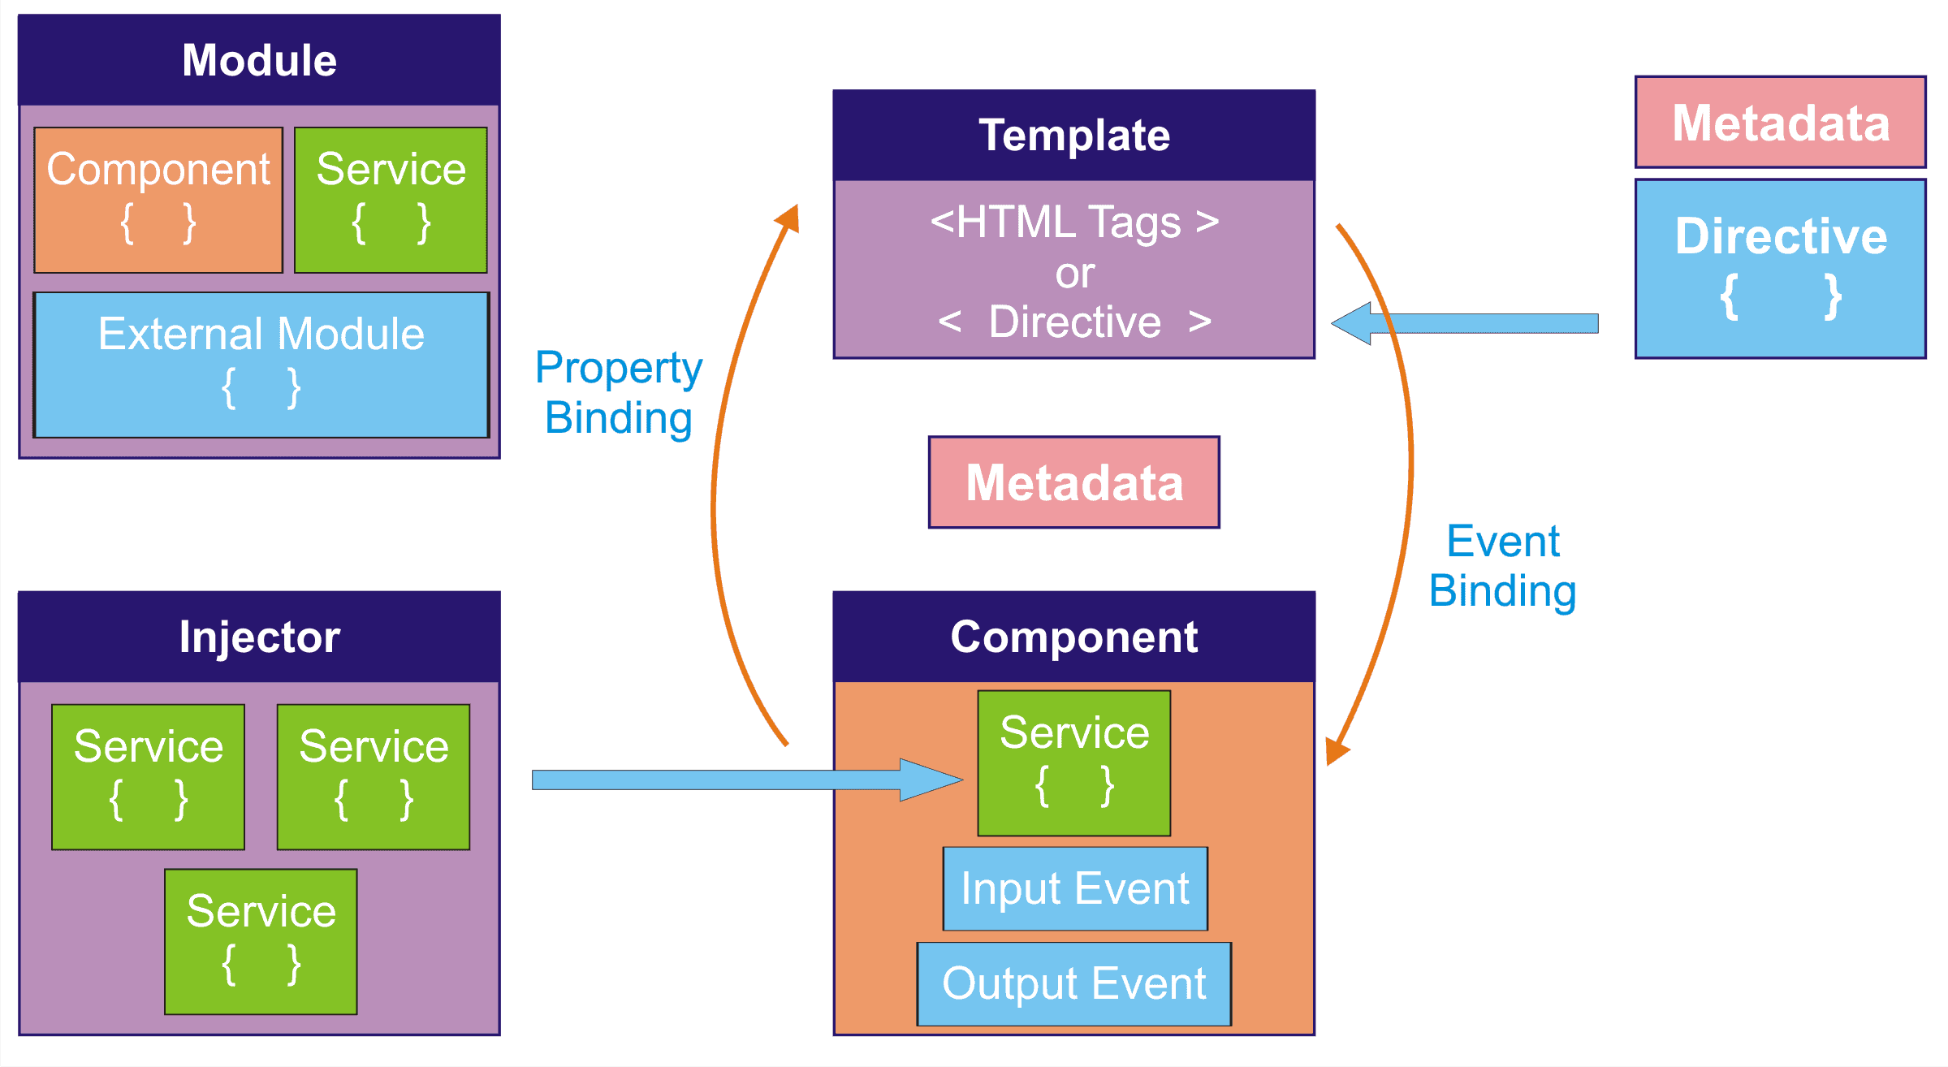
ANGULAR Architecture

Slide 19
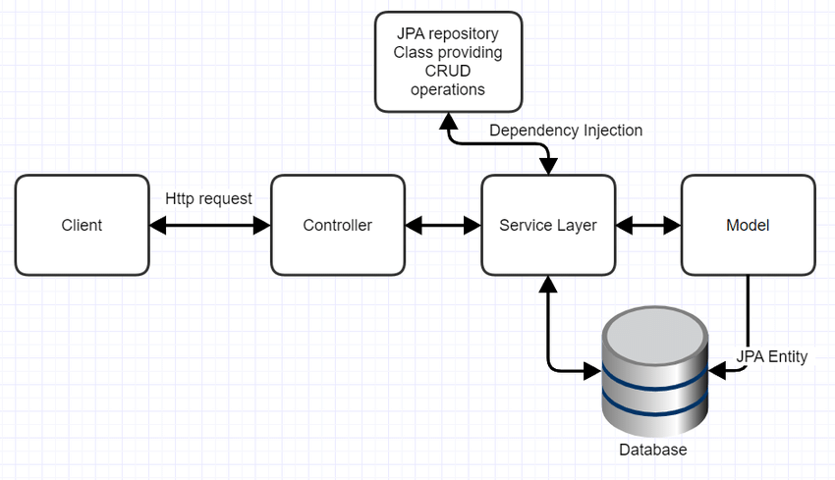
SPRING ARCHITECTURE

Slide 20
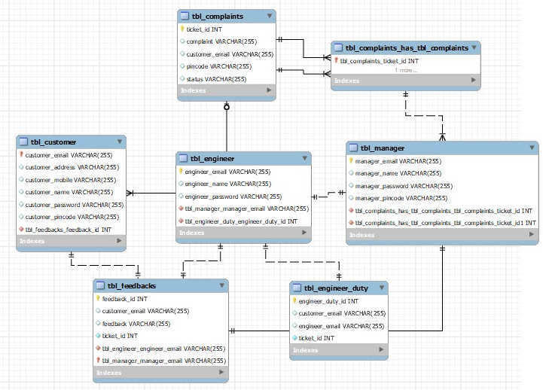
Database Schema

Slide 21
Database Scheme design
Create a Database tables
Customer, Manager, Engineer, Feedback, Engineer Duty, Complaints
Front End Development
Register, Login Screen
Admin, Customer, Manager, Engineer Activities
Backend Development
RESTful Web API to perform CRUD operations on Domain objects Using Spring Boot and MYSQL Database
Unit Testing

Slide 22
Backend
Create Different Entity Classes for Customer, Complaints, Managers, Engineers, Feedback and Engineer Duty.
The controller class for all the users in which it is responsible for processing incoming REST API requests, preparing a model, and returning the view to be rendered as a response.
The controller classes in Spring are annotated either by the @Controller or the @RestController annotation.
These mark controller classes as a request handler to allow Spring to recognize it as a RESTful service during runtime.

Slide 23
Jpa Repository contains the APIs for basic CRUD operations
@Repository annotation helps us to convert the non-spring-based expectation to a spring unchecked exception.
Basically, we implement this repository as the interface in Java and extend different repositories available
This is a very important layer because all the transactions happened inside this only so we need to track this if any exception occurred.
The program is mainly a console program, and the data is saved in the H2 database.
Spring boot service component is defined as a class file that includes the @Service annotation and allows developers to add business functionalities.

Slide 24
Front End
Spring Boot and Angular form a powerful tandem that works great for developing web applications with a minimal footprint.
Created angular components such as
Admin
Manager
Engineer
Customer
Feedback
Complaints
Respective Service and Models were created

Slide 25
IMPLEMENTATION

Slide 26
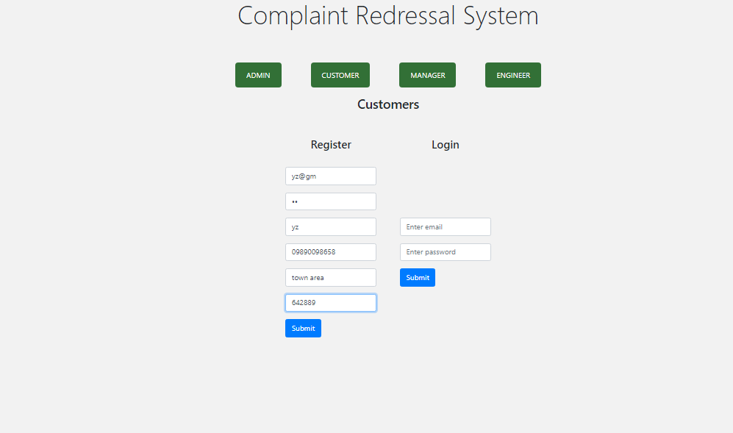
Register as customer

Slide 27
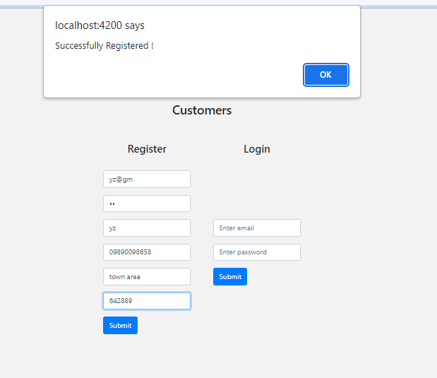

Slide 28
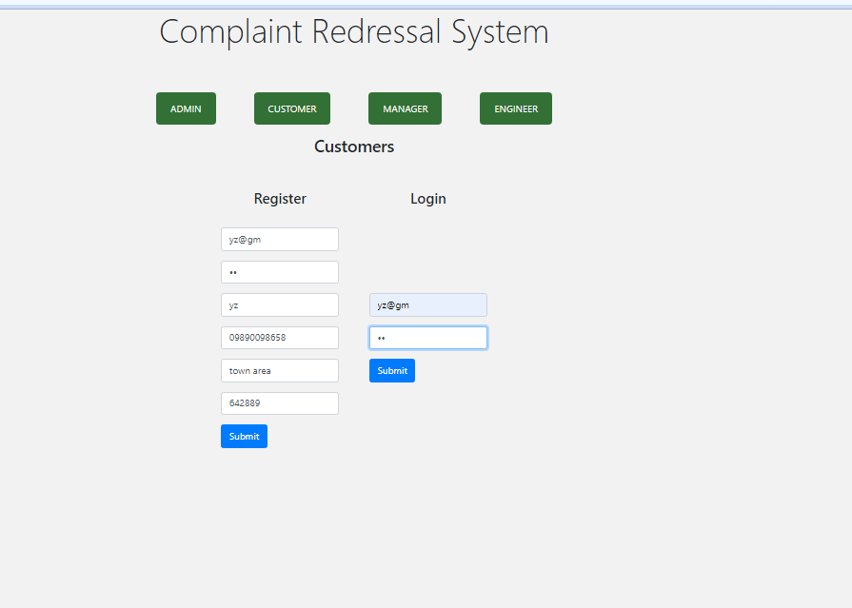
Customer Login

Slide 29
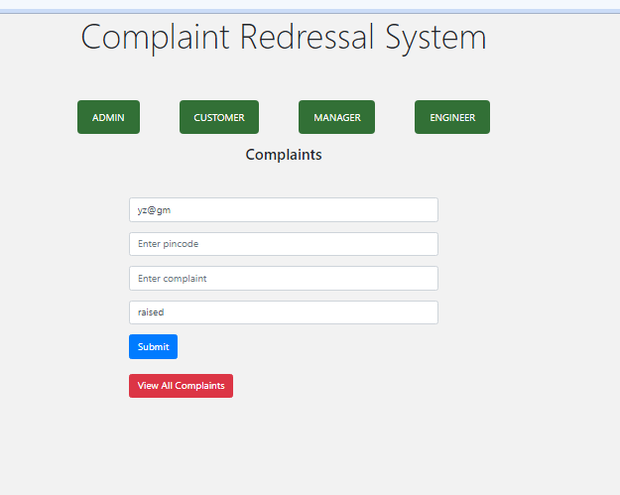
Create Ticket

Slide 30
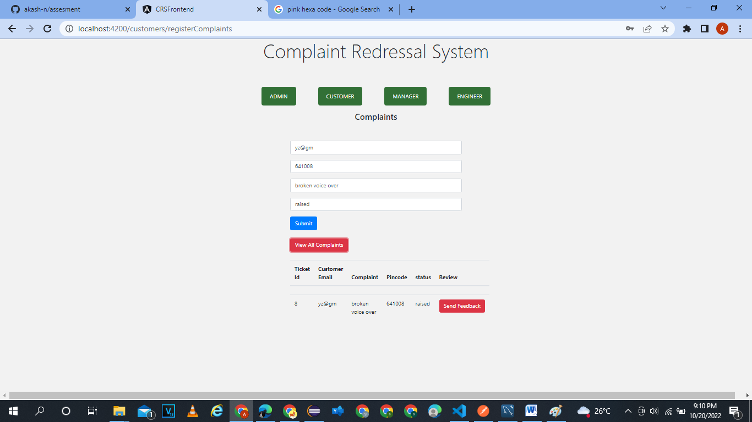
View Complain

Slide 31
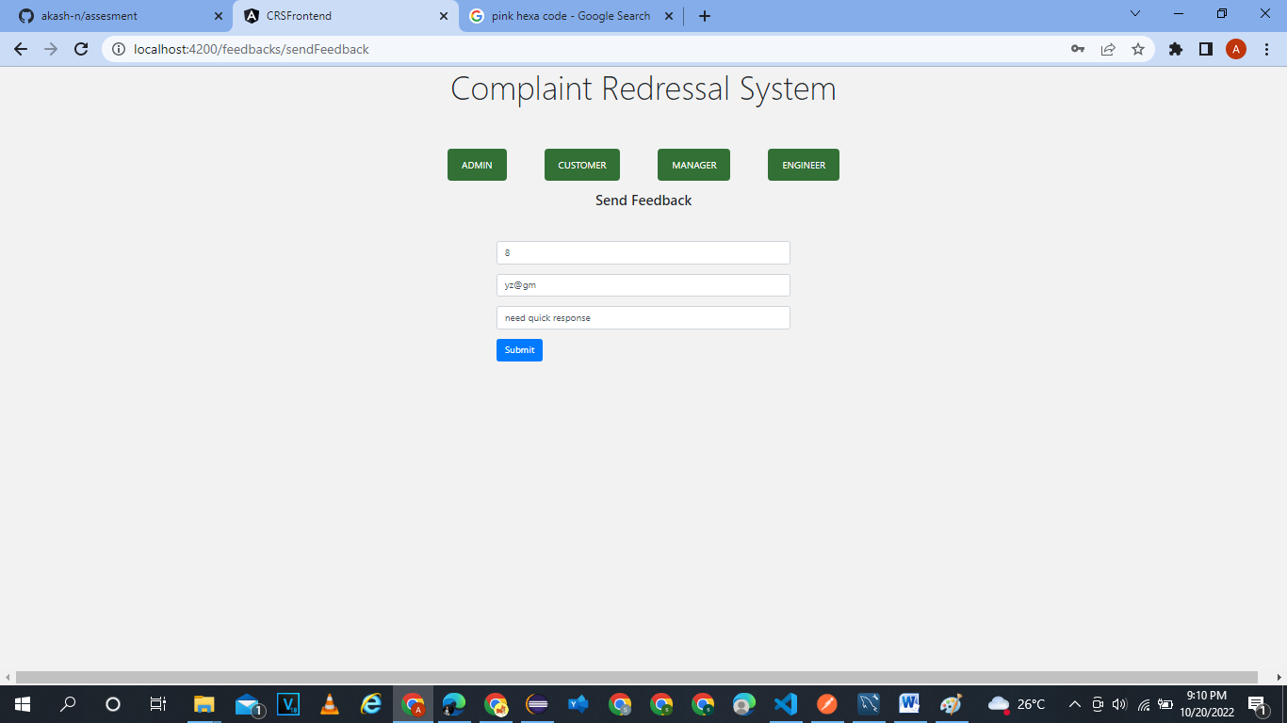
ADD feedback

Slide 32
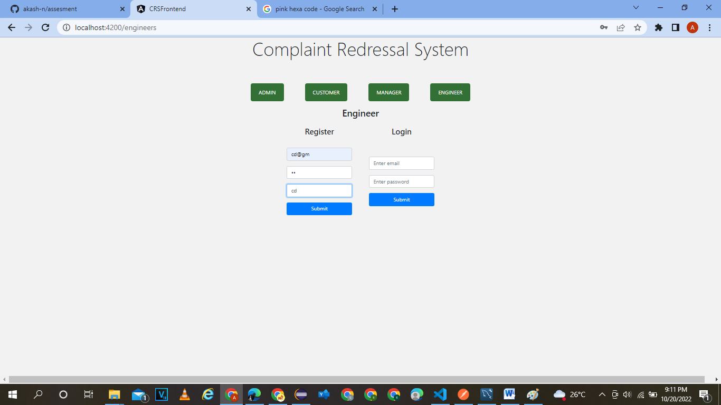
Register engineer

Slide 33
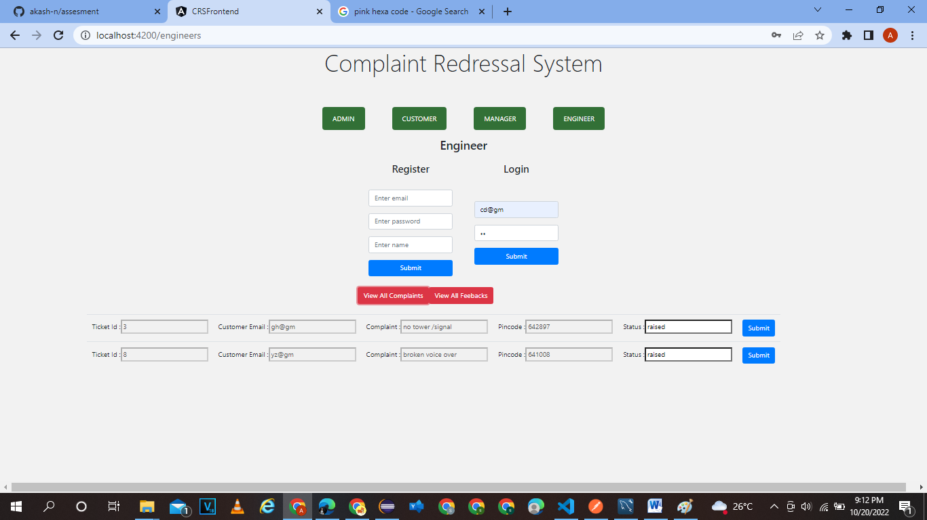
Change status

Slide 34
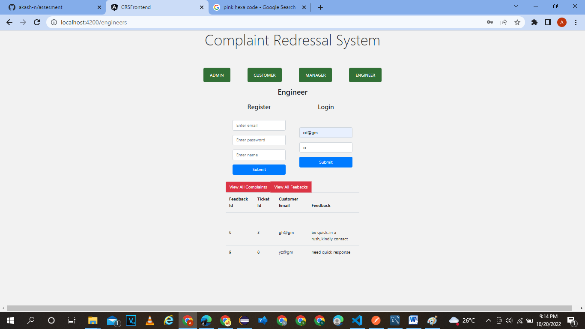
View feedback

Slide 35
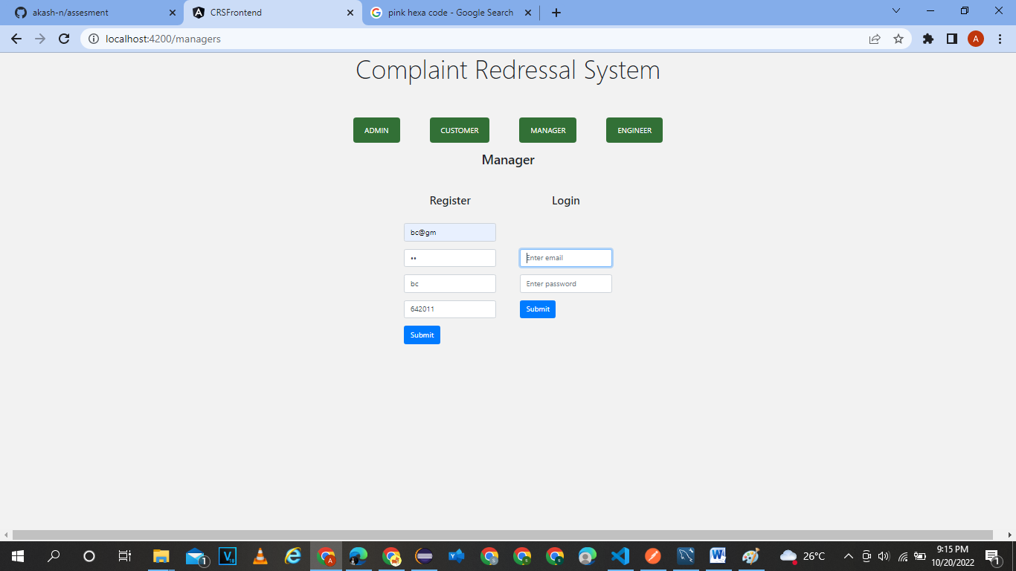
Manager registration

Slide 36
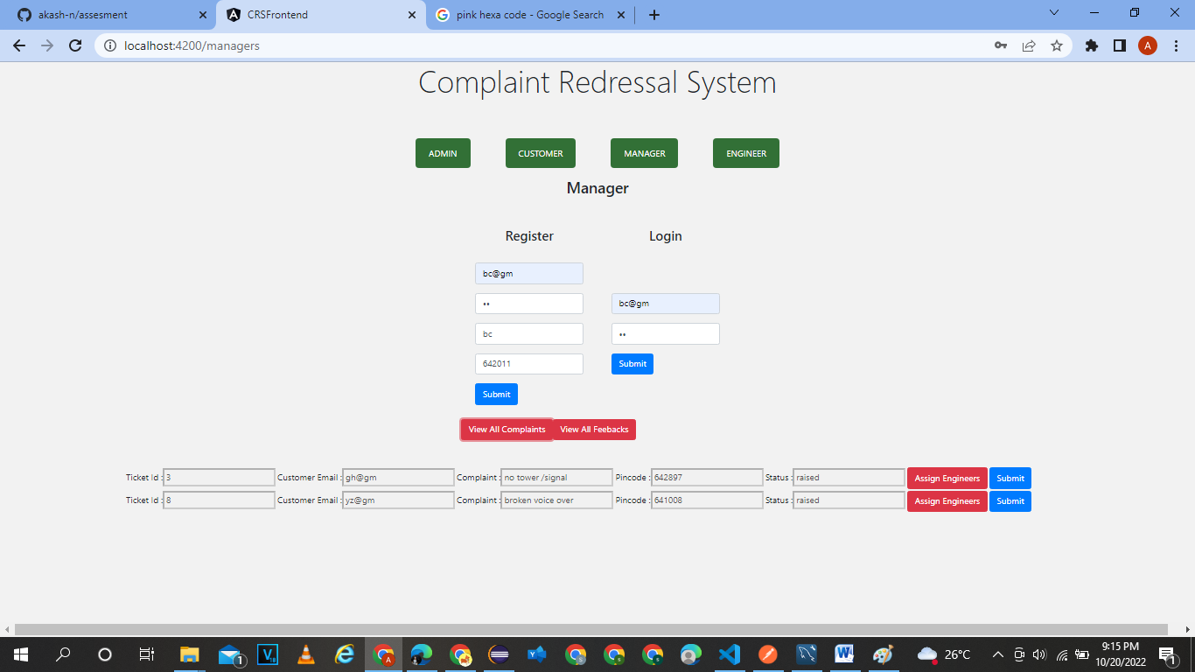
MANAGER LOGIN ,VIEW COMPLAINTS

Slide 37
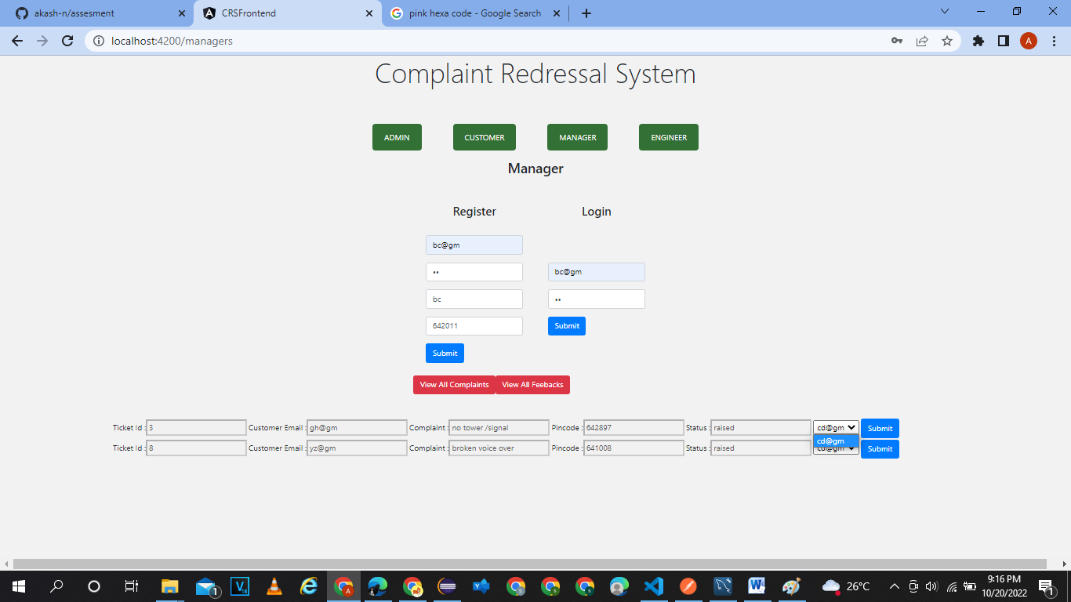
ASSIGN ENGINNER

Slide 38
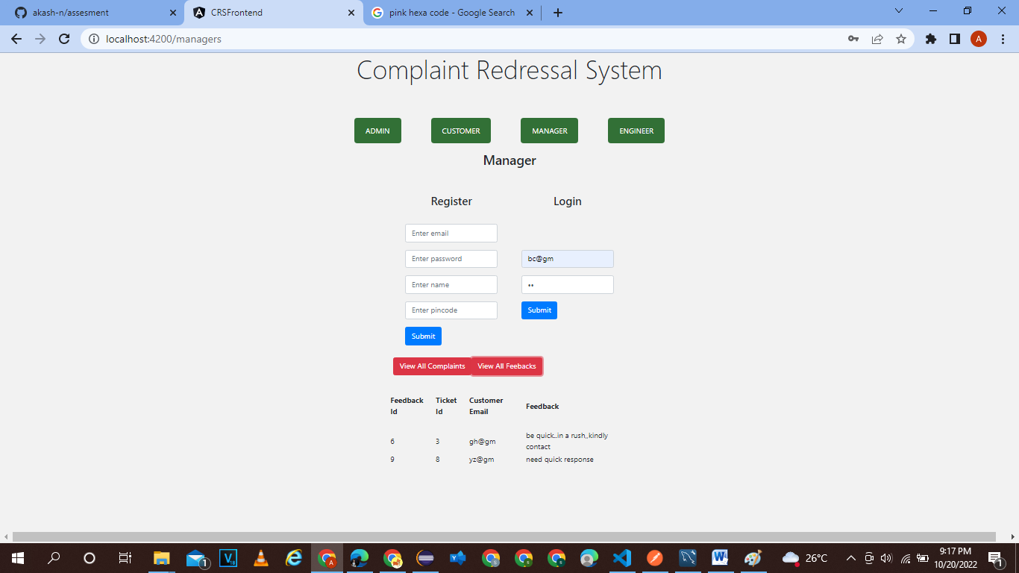
VIEW FEEDBACK AS A MANAGER

Slide 39
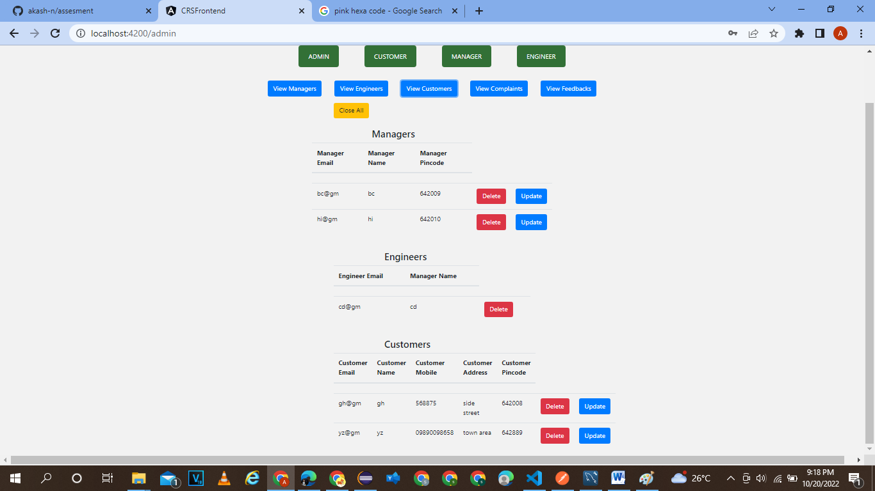
Admin Control life cycle of manager ,customer and engineer

Slide 40
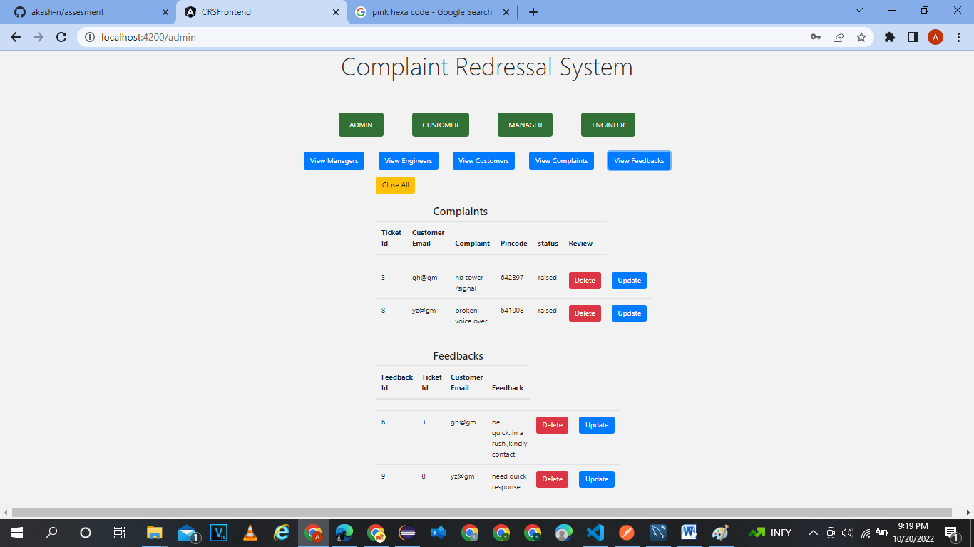
VIEW COMPALIN DETAILS AND FEEDBACK

Slide 41
TESTING
Via POSTMAN

Slide 42
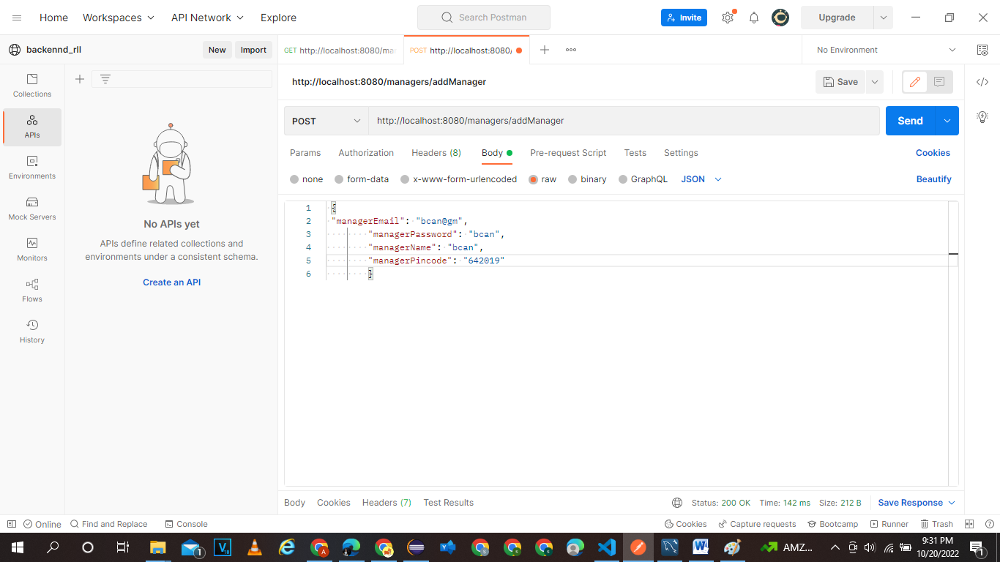
ADD NEW MANAGER http://localhost:8080/managers/addmanager

Slide 43
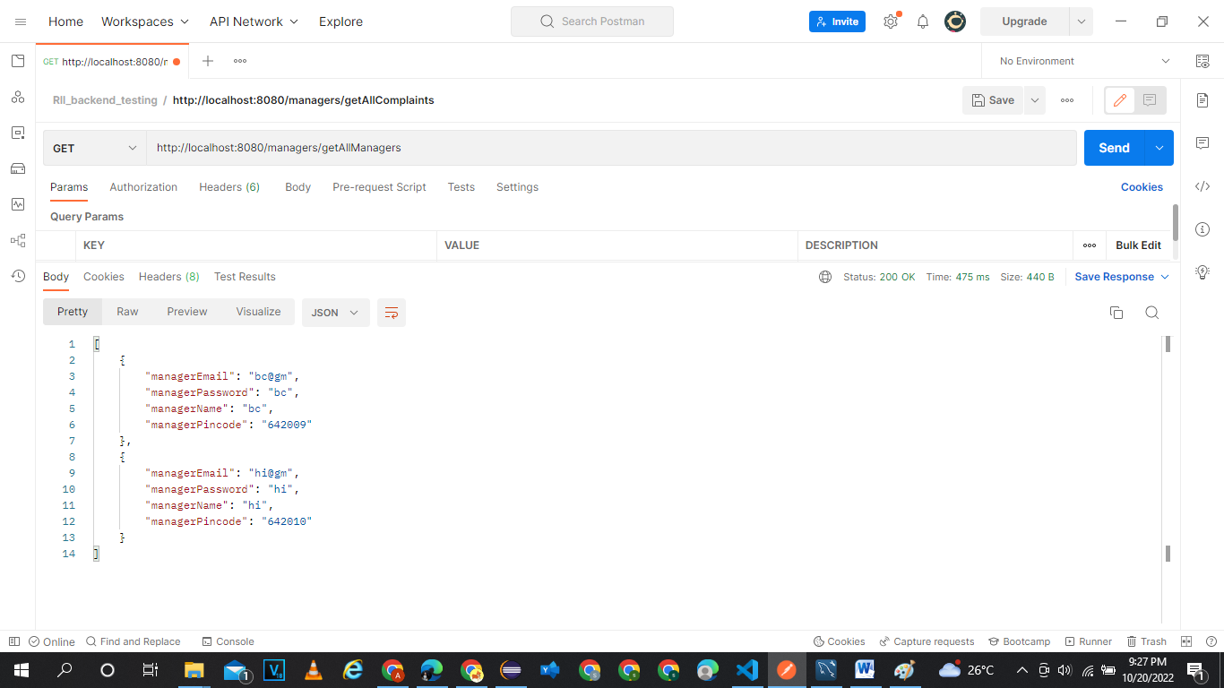
GET ALL MANAGER http://localhost:8080/managers/getallmanagers

Slide 44
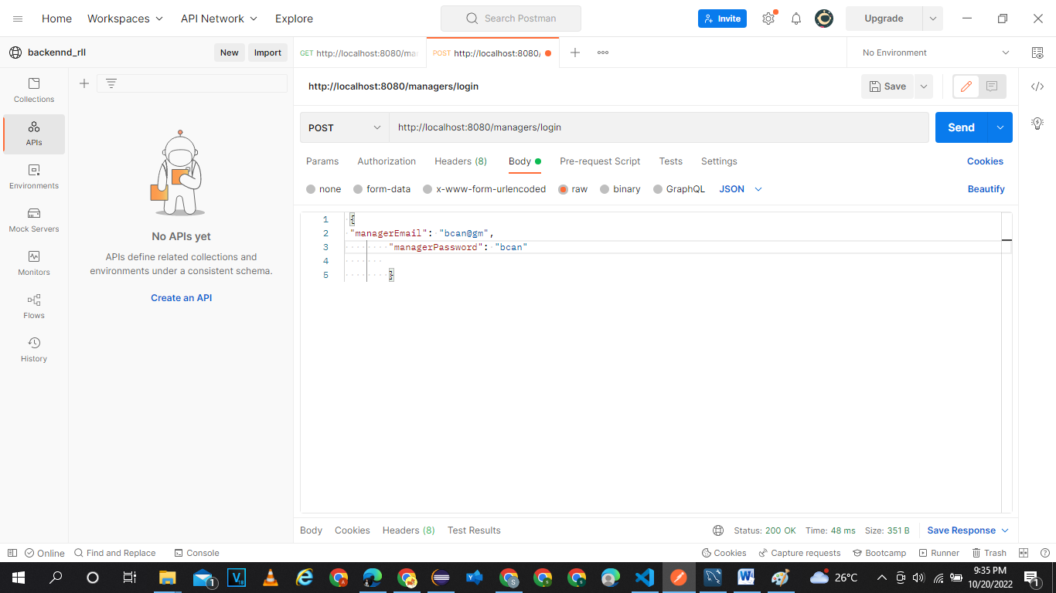
Login as manager

Slide 45
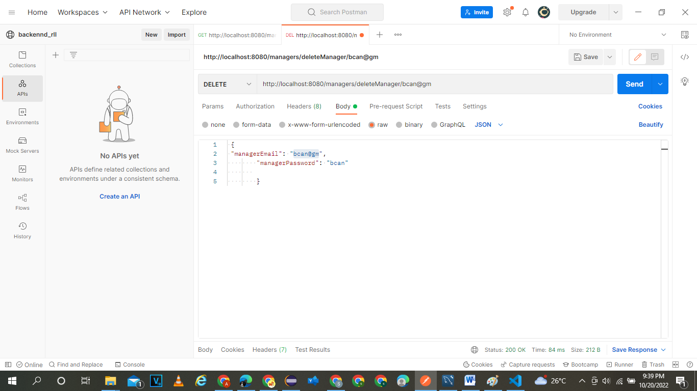
DELETE MANGER-THROUGH MAIL ID http://localhost:8080/managers/deletemanager/bcan@gm

Slide 46
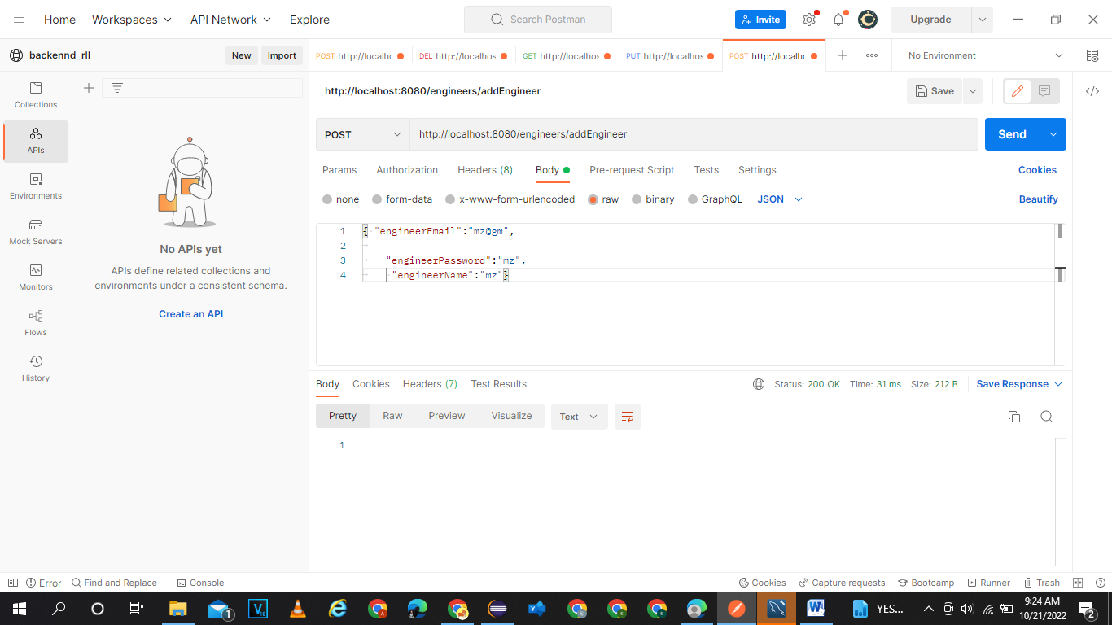
ADD ENGINEER http://localhost:8080/engineers/addengineer

Slide 47
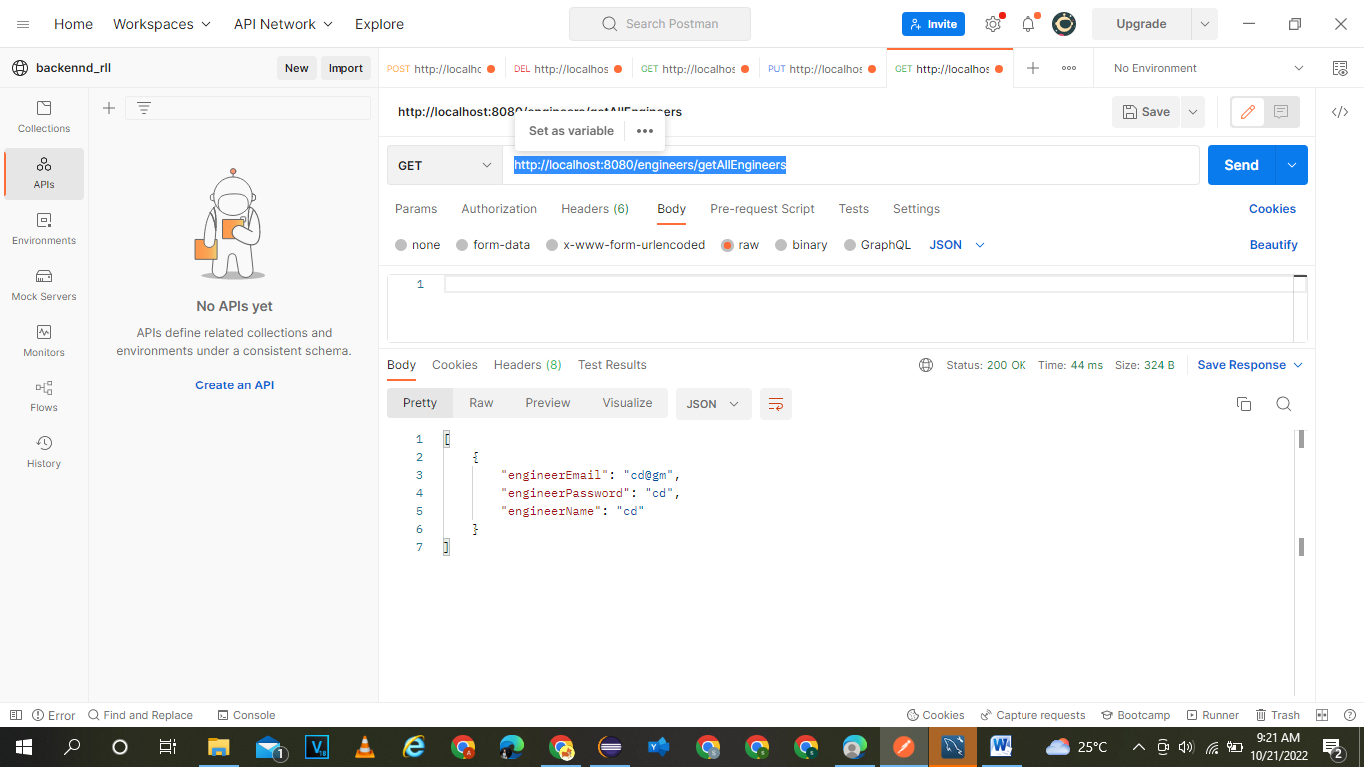
GET ALL ENGINEERS http://localhost:8080/engineers/getallengineers

Slide 48
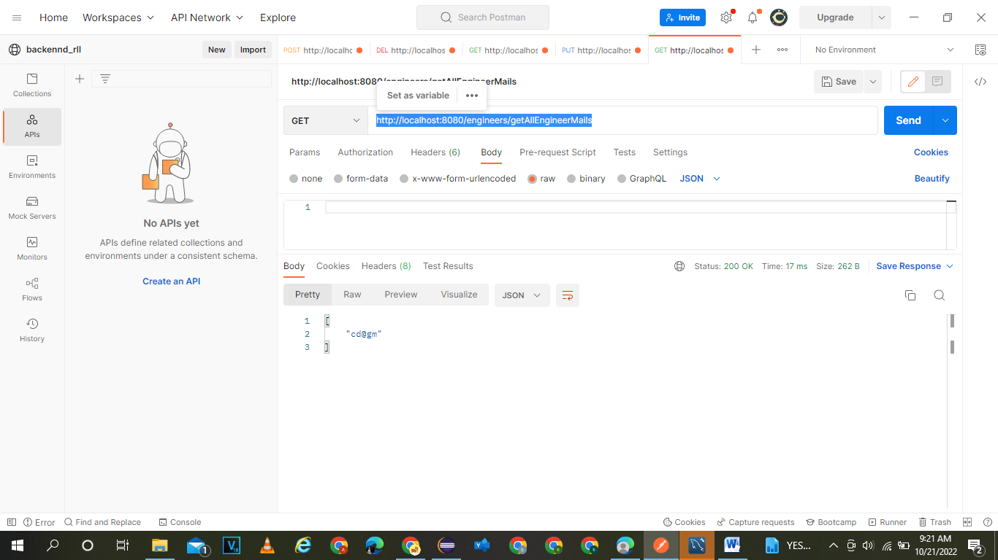
GET ALL ENGINEER BY MAIL http://localhost:8080/engineers/getallengineermails

Slide 49
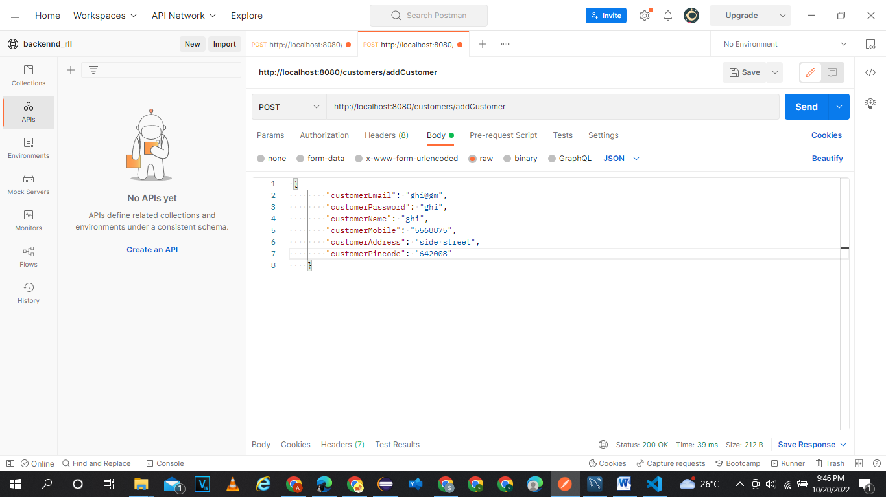
ADD CUSTOMER http://localhost:8080/customers/addcustomer

Slide 50
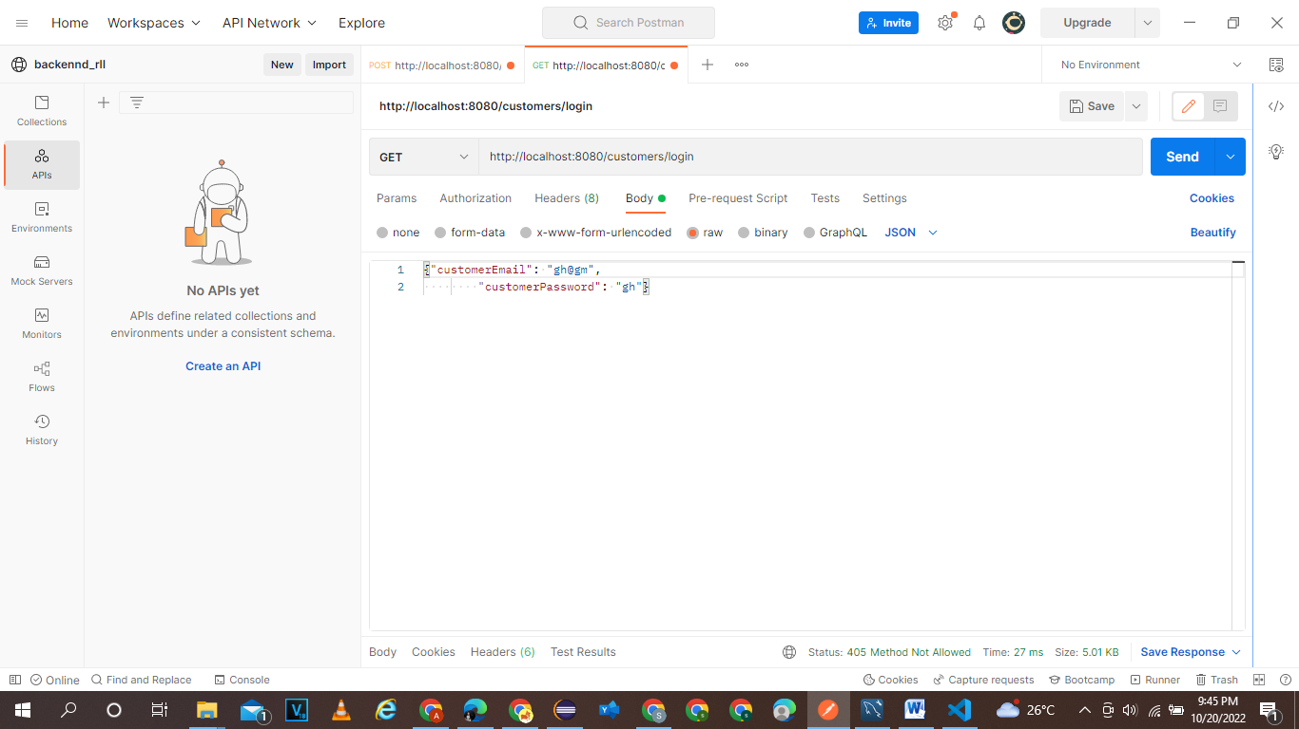
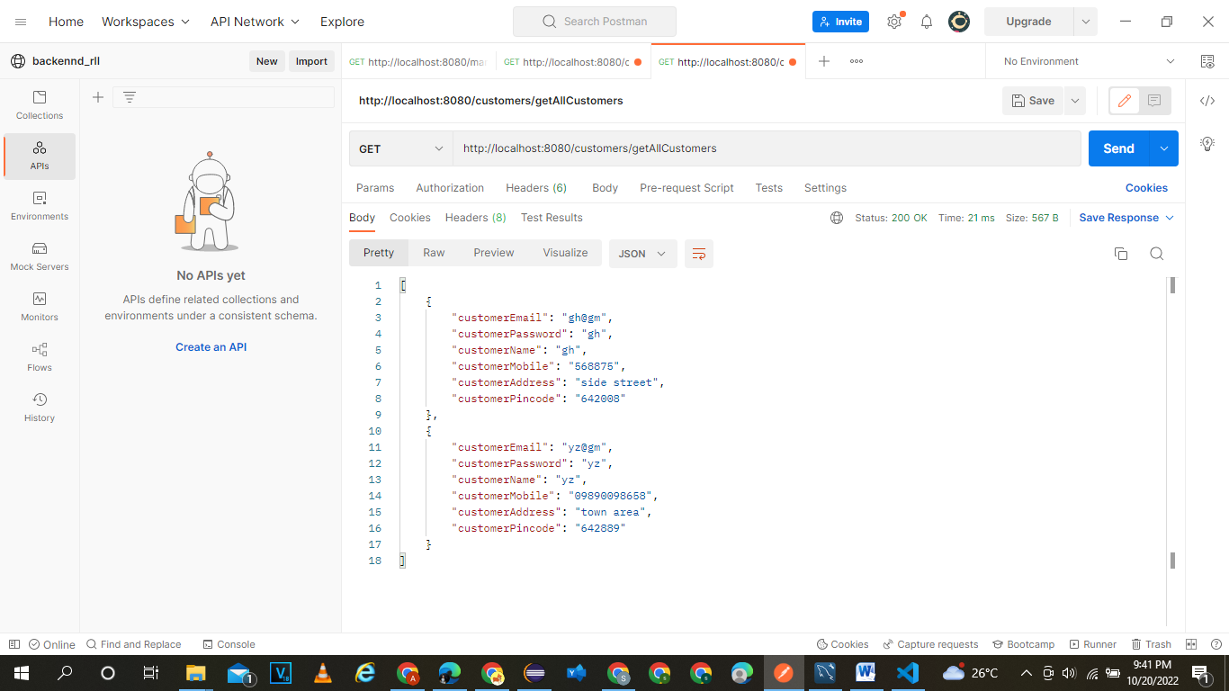
GET ALL CUSTOMER http://localhost:8080/customers/getallcustomers
LOGIN AS A CUSTOMER

Slide 51
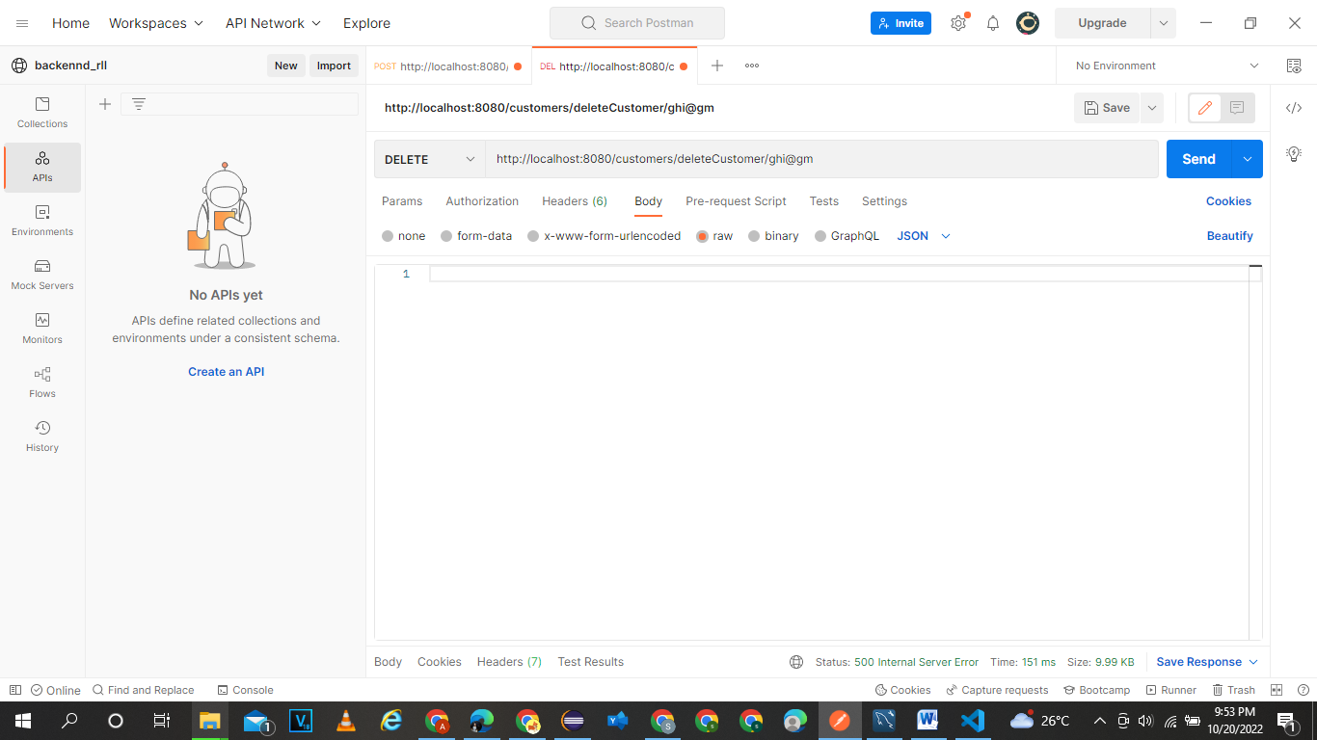
DELETE AN CUSTOMER http://localhost:8080/customers/deletecustomer/ghi@gm

Slide 52
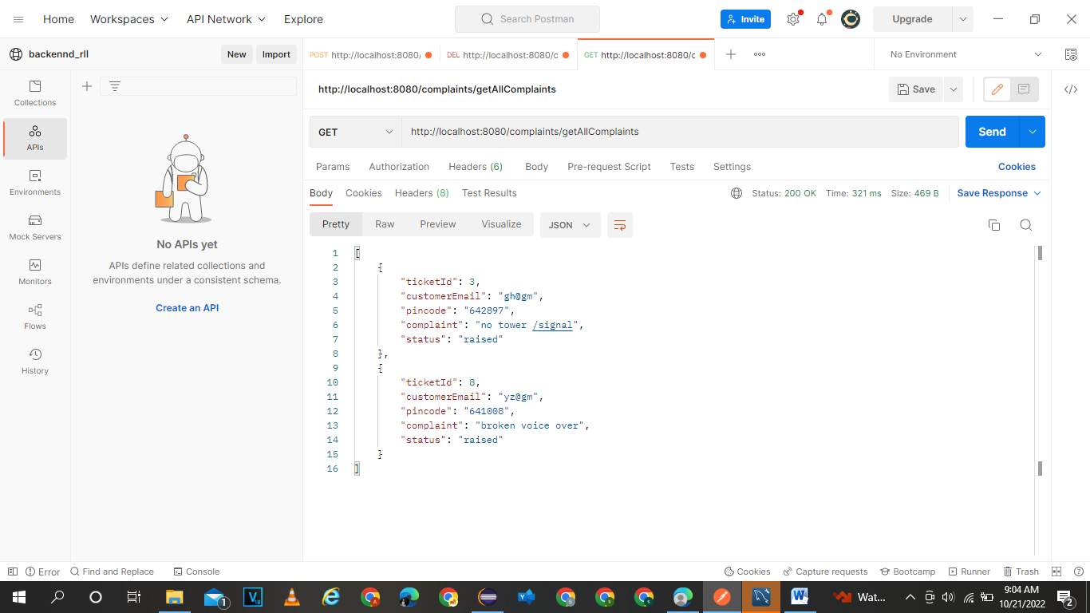
GET ALL COMPLAINTS http://localhost:8080/complaints/getallcomplaints

Slide 53
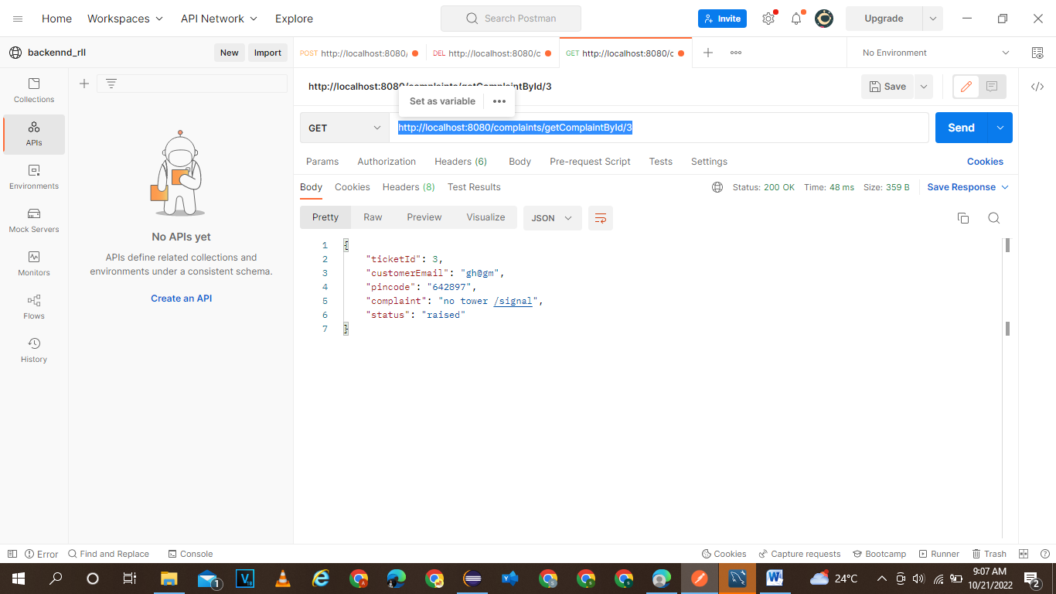
Get complaint by ticket id: http://localhost:8080/complaints/getcomplaintbyid/3

Slide 54
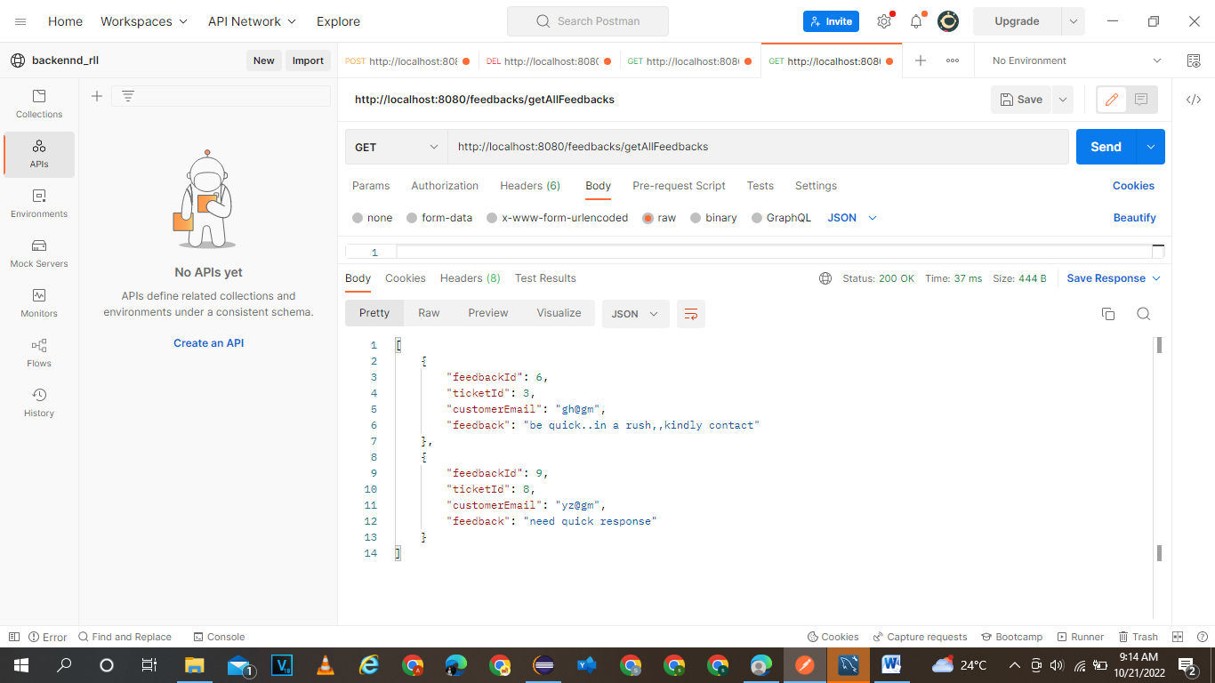
Get all feedbacks http://localhost:8080/feedbacks/getallfeedbacks

Slide 55
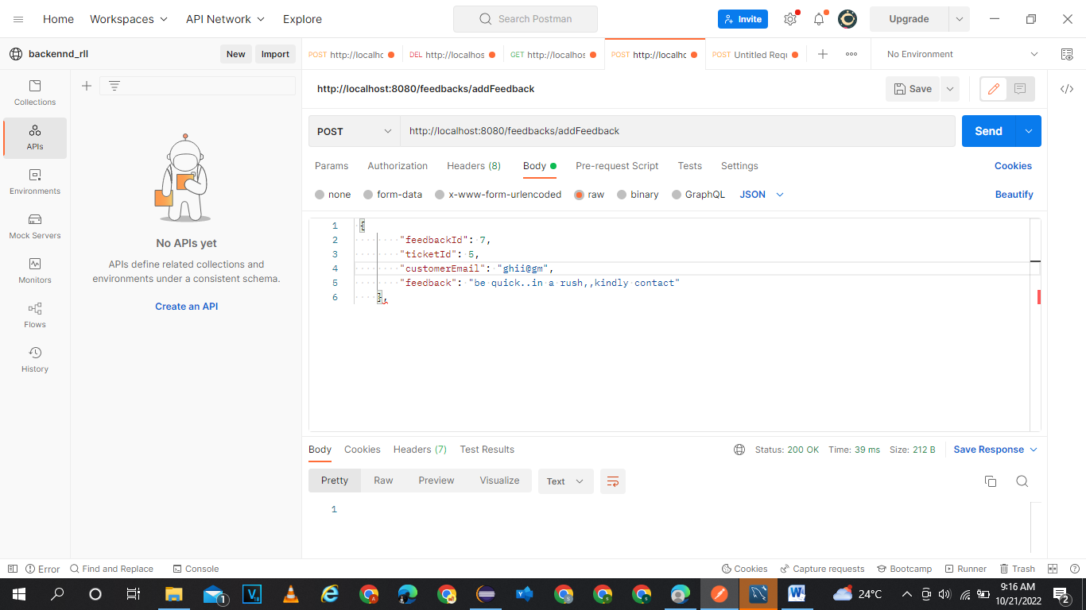
ADD FEEDBACK http://localhost:8080/feedbacks/addfeedback

Slide 56
THANK YOU
2
+
2
+

Slide 57
Customize this Template
Template Editing Instructions and Feedback

